Slide 1
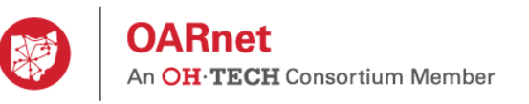
Bomgar Secure Remote Access
OARNET Presentation

Slide 2
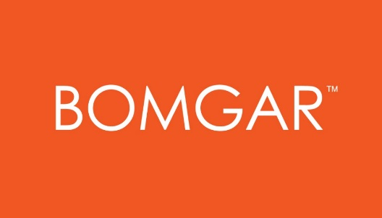

ABOUT BOMGAR
Founded in 2003
280+ Employees
10,000+ customers in 65+ countries
Global offices in US, EMEA & APAC
Recognized in the Inc. 500/5000 as “America’s Fastest Growing Private Companies” for 6 years running

Slide 3





















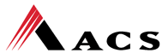
























LOYAL CUSTOMERS
10,000+ companies around the world trust Bomgar
Notes:
We’re about

Slide 4















OHIO CUSTOMERS

Slide 5
Bowling Green University Use Case
BGSU has standardized on Bomgar across the university system
Central IT handles 60-80 chat sessions/day through Bomgar
HR uses Bomgar chat to offer secure assistance to end users
Purchasing and Marketing leverage Bomgar to securely access systems in the dept.
BGSU deployed active jump clients to securely manage all lab machines
Branded Bomgar to have the look and feel of BGSU---leveraged Bomgar API to deploy Bomgar landing page on the BGSU home page
Integrating Bomgar with Team Dynamix (ticketing) to centralize IT operations, ensure data integrity and drive KPI metrics such as first call resolution, CSAT and agent utilization

Slide 6
Ohio DPS Use Case
Emergency Management Agency (EMA) utilizes Bomgar to securely access central command center
Leads and DPS leverage Bomgar to securely support laptops in patrol cars
Bomgar’s security architecture allows DPS to meet CJIS, FERPA, and PCI Compliance standards
  All remote access data stays with DPS’s 4 walls
  End to end reporting of all sessions, including session recording
  AD integration to ensure there is tech accountability for remote sessions
  Granular permission rights tied to specific users
    I.e Level 1 support is not accessing systems outside of their scope of duties

Slide 7
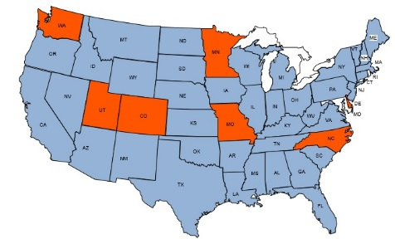
STATES THAT HAVE STANDARDIZED ON BOMGAR
Colorado
Delaware
North Carolina
Minnesota
Missouri
Utah
Washington

Slide 8




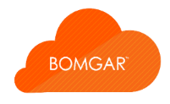
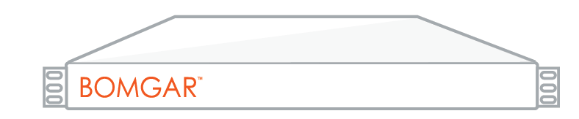

BOMGAR SOLUTION PORTFOLIOS
BOMGAR
Remote Support
BOMGAR
Privileged Access Management
SERVICE DESK
CUSTOMER SUPPORT
VENDOR ACCESS
PRIVILEGED
ACCESS
Secure Access Platform
VIRTUAL APPLIANCE
PHYSICAL APPLIANCE
SECURE CLOUD
Notes:
Access, control, & troubleshoot remote desktops, servers, and mobile devices, no matter the operating system or network location.
Chat, co-browse, and provide remote assistance for your customers. Even support iPad, iPhone or Android apps.
Control, monitor and manage third-party and vendor access to your corporate network and devices
Manage, empower, and audit internal privileged users to securely access your sensitive and critical systems.

Slide 9

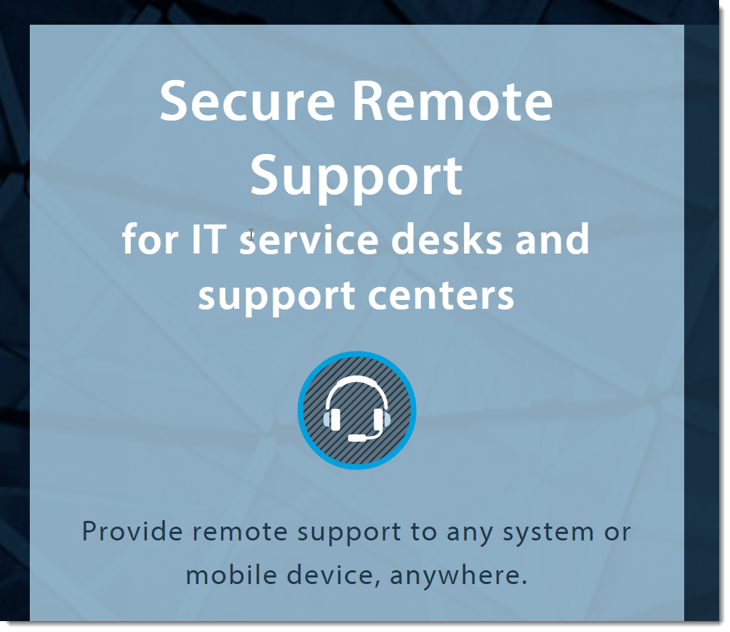

Slide 10

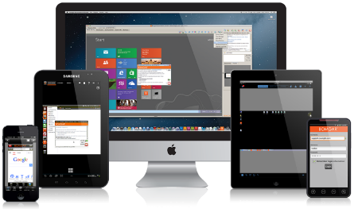
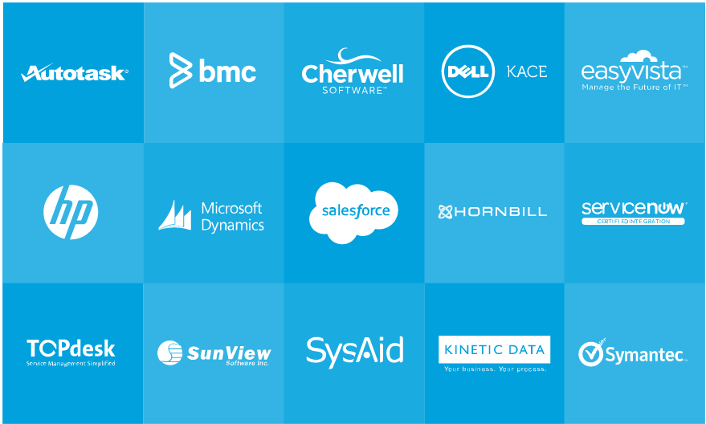

BOMGAR ENTERPRISE REMOTE SUPPORT FEATURES
CONSOLIDATION
SERVICE LEVELS
INTEGRATION
SECURITY

Slide 11
BOMGAR ENTERPRISE REMOTE SUPPORT FEATURES
Why Consolidate?
Technician and customer confusion
Cost and maintenance of multiple tools
Most Point-to-Point tools offer little or no logging
Too many places to go look for problems
CONSOLIDATION
Support Multiple Platforms
Support Mobile Devices
On or Off Network
All with Bomgar

Slide 12
BOMGAR ENTERPRISE REMOTE SUPPORT FEATURES
Improve your Service Desk’s most important Metrics
First Call Resolution
Incident Handling Time
Customer Satisfaction
SERVICE LEVELS
Bomgar chat is designed for the technical support call center.
Integrate chat with your website, portal, or mobile app
Route inbound calls to the right team
Manage canned messages & responses.
Easily elevate to full remote control with one easy click.
Increased First Call Resolution
Collaboration and Escalation
Easy Session Initiation
Chat-based Support

Slide 13
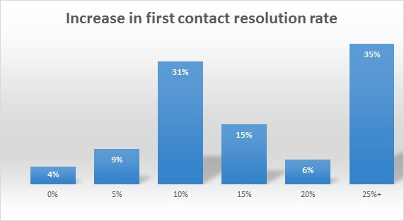
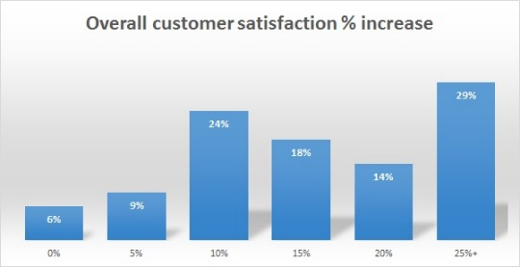
SERVICE LEVEL RESULTS
More than one third of customers saw an increase of 25% or more in First Call Resolution
SERVICE LEVELS
Increased First Call Resolution
Collaboration and Escalation
Easy Session Initiation
Chat-based Support
More than 43% of respondents had an increase in customer satisfaction of 20% or more

Slide 14
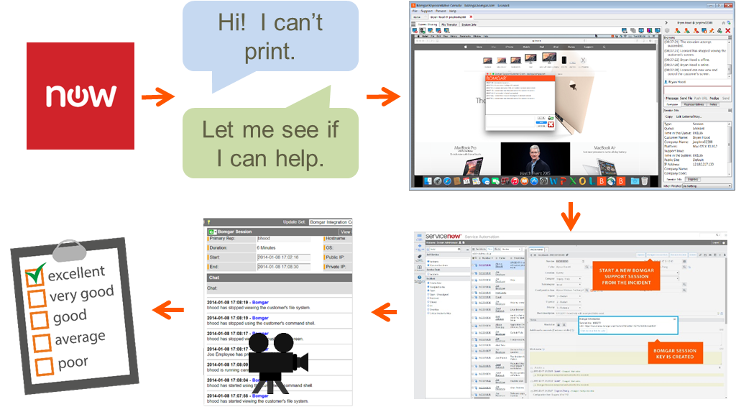
BOMGAR ENTERPRISE REMOTE SUPPORT FEATURES
INTEGRATION
ITSM/CRM System
Ticketing Systems
Security Providers
Inventory Systems
Why Integrate?
Launch a remote support session directly from an incident within your ticketing system, and automatically update tickets with details from the support session

Slide 15
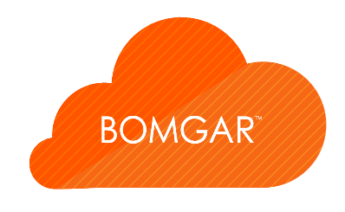
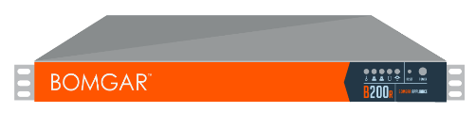
BOMGAR ENTERPRISE REMOTE SUPPORT FEATURES
Single Tenant – No shared software
SECURITY
Your Identity
Your DNS Name
SSL Certificate
Customized Graphics
The Appliance
Centralized Management
Centralized Reporting
Multiple Deployment Options
Centralized management, authentication and reporting

Slide 16
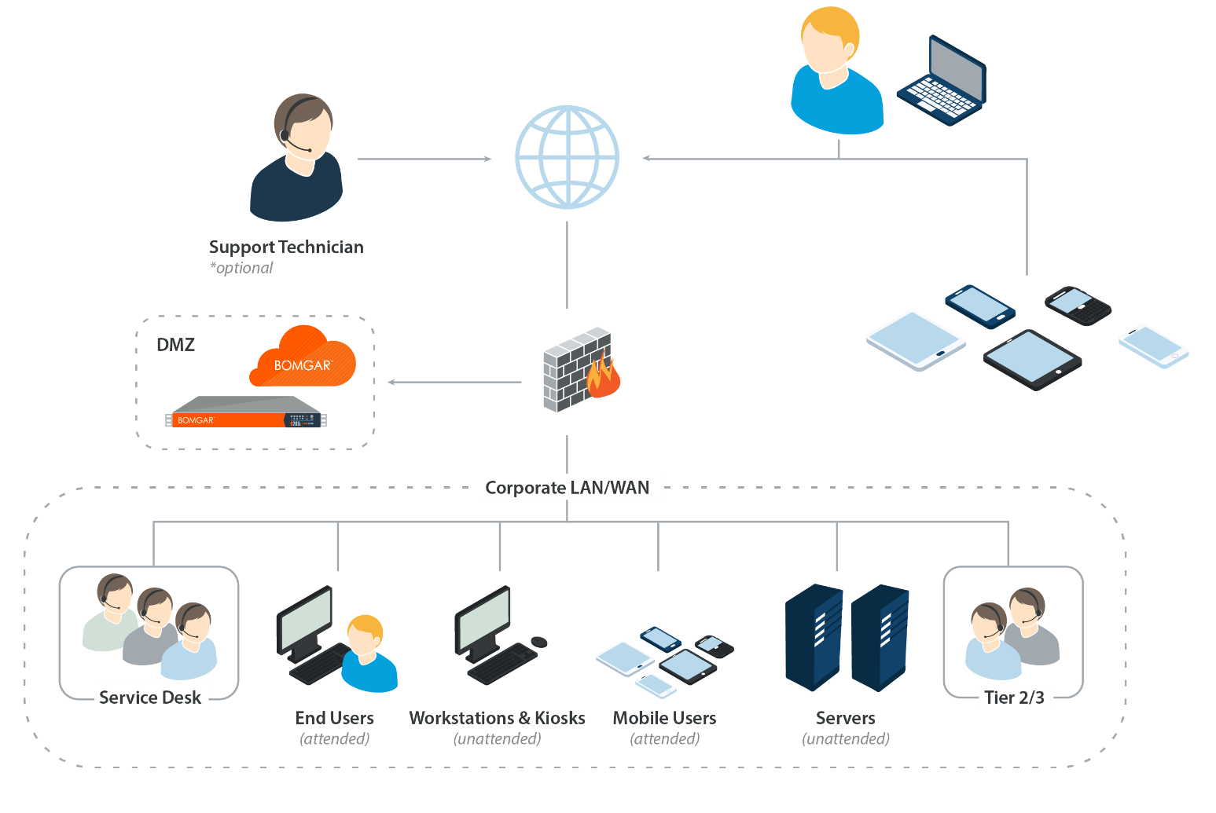
DEPLOYMENT: ON-PREMISES IN THE DMZ

Slide 17
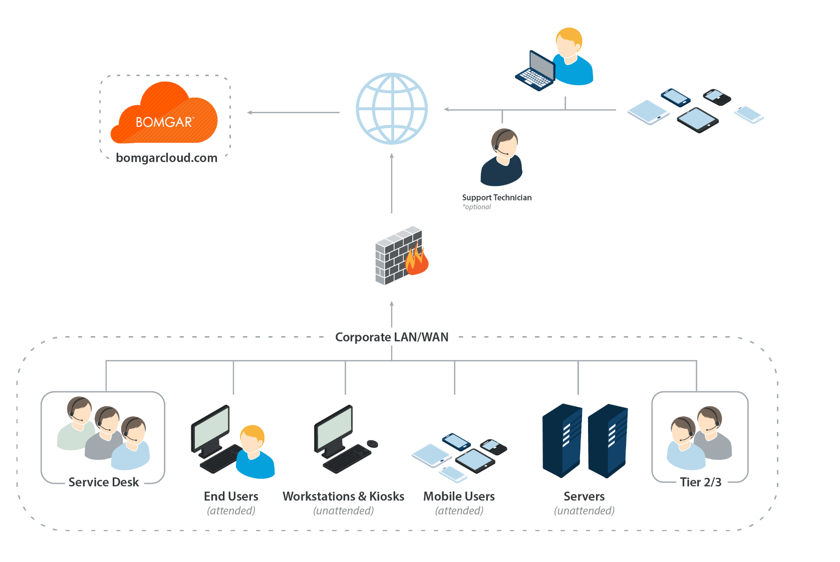
DEPLOYMENT: SECURE CLOUD

Slide 18
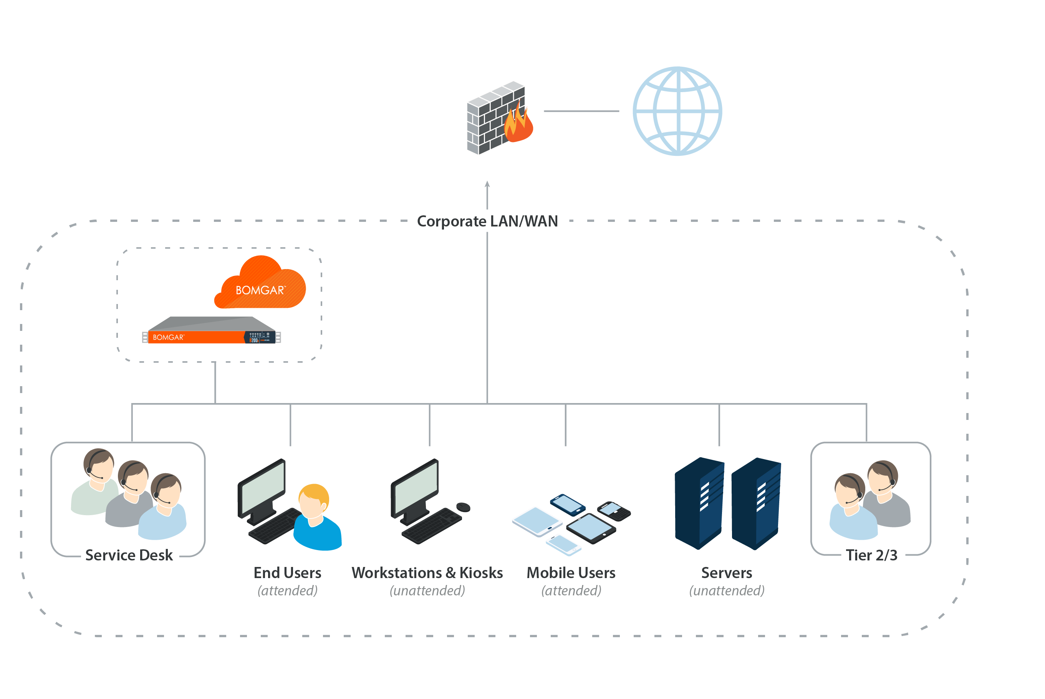
DEPLOYMENT: ON-PREMISES ON LAN/WAN

Slide 19
BOMGAR SOLUTION PORTFOLIOS
BOMGAR
Remote Support
BOMGAR
Privileged Access Management
SERVICE DESK
CUSTOMER SUPPORT
VENDOR ACCESS
PRIVILEGED
ACCESS
Secure Access Platform
VIRTUAL APPLIANCE
PHYSICAL APPLIANCE
SECURE CLOUD
Notes:
Access, control, & troubleshoot remote desktops, servers, and mobile devices, no matter the operating system or network location.
Chat, co-browse, and provide remote assistance for your customers. Even support iPad, iPhone or Android apps.
Control, monitor and manage third-party and vendor access to your corporate network and devices
Manage, empower, and audit internal privileged users to securely access your sensitive and critical systems.

Slide 20

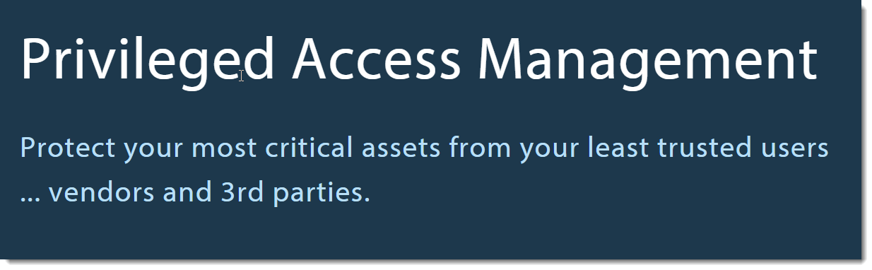

Slide 21
PRIVILEGED ACCESS MANAGEMENT (PAM)
(Gartner definition)
Privileged Access Management technologies help organizations shrink the attack surface on critical assets and meet compliance requirements by securing, managing, and monitoring access to sensitive systems.
Subset of the Identity & Access Management (IAM) Space
PAM
Privileged session management (PSM)
Superuser privilege management (SUPM)
Shared account password management (SAPM)
Application-to-application password management (AAPM)

Slide 22

WHY is there interest in PAM technology?
Risk associated with both, insiders (employees, contractors, 3rd party partners)/ outsiders (ex-employees, ex-contractors, HACKERS)
Regulation and failed audits, as auditors are paying more attention to Privileged “Accounts” and trail of evidence of Privileged “Access”
The existence and proliferation of malware that specifically targets privileged user accounts
Vulnerability in legacy protocols (VPN, RDP, SSH, Telnet, VNC, etc)
Balance of productivity and security
Notes:
We’re about

Slide 23






BOMGAR CAPABILITIES
SECURE REMOTE ACCESS
Extend remote connection protocols, such as RDP, command shell, SSH, and Telnet, beyond the LAN without compromising security. Connections are secured by the highest level of encryption.
MONITOR & AUDIT
Monitor sessions in real-time. Review tamper-proof audit trails, including searchable video recordings, and detailed logs of screen sharing, file transfer, and shell activity.
GRANULAR ACCESS CONTROL
Require access notification and authorization. Define what endpoints users can access, schedule when they can access them, and whitelist applications.
NO VPN TUNNEL
Allow users and vendors to connect to any system from anywhere, on or off your network. Enable remote access without VPN tunneling, port-forwarding, or complex firewall configurations. No need to re-architect your network.
COLLABORATION WITHIN SESSIONS
Ensure critical systems stay up and running. Allow users to pull both internal and external skilled resources into sessions to build, maintain, and support business services together.
SECURE MOBILE APPS
Connect securely from mobile
devices. Native mobile apps give technicians desktop-quality access over 3G/WiFi from Android or iOS devices.
Notes:
We’re about

Slide 24











How Bomgar secures vendor access?
CORPORATE NETWORK
✓
✓
LOW
TRUST LEVEL
THIRD-PARTY VENDOR
Layered Protections
Broker the connection
Application whitelist / blacklist
Outbound connections
Access timeframes
Multi-factor authentication
Access approval workflow
Access to specific systems
Full audit trail with video
Notes:
At the end of the day, your third-party vendors still need access to your network. So how can you give them access without a VPN?

Slide 25




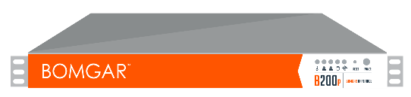
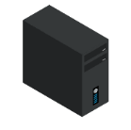

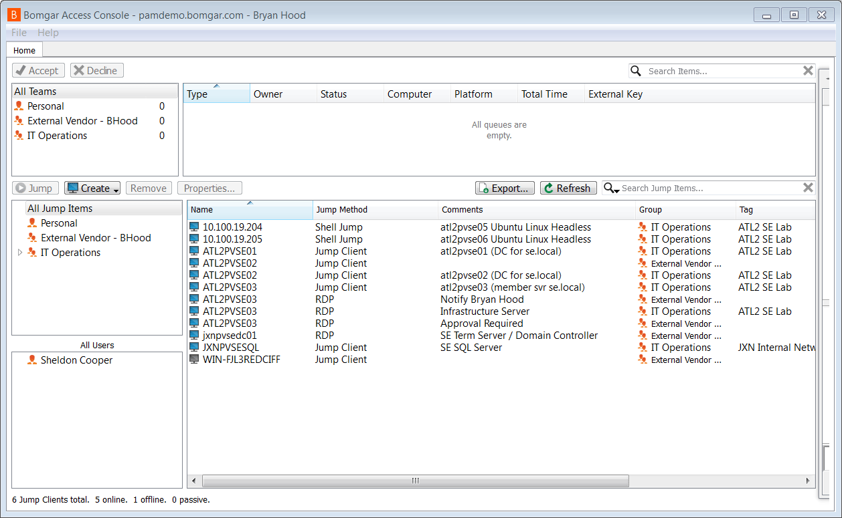



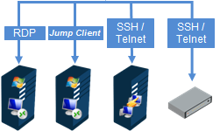
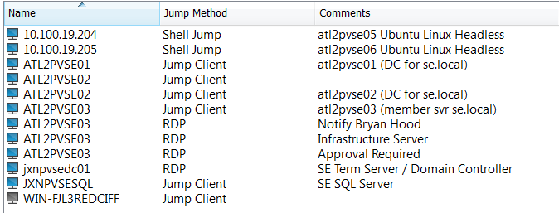

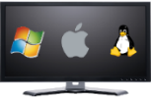
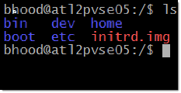

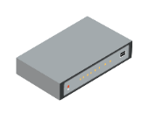

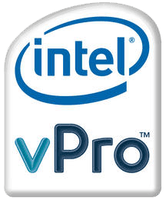

Extend remote connection protocols beyond the LAN without compromising security by using a Layer 7 (Application) approach that incorporates much tighter controls than those available with a traditional VPN
443
DMZ
Professor/University Employee
University LAN/WAN
443
443
Bomgar
Jumpoint
Bomgar Access Console
Bomgar Jump (Agent)
RDP
vPro
SSH /
Telnet
SSH /
Telnet
Jump Client
Agent Based
Console Access
Headless Jump Client
Agent Based
Terminal Access

Slide 26

Thanks For Your Time
Travis Britt RSM | Brian Page Solutions Engineer
tbritt@Bomgar.com (770) 807-5850 | bpage@Bomgar.com (770) 407-1818

Slide 27
Bomgar Enterprise Remote Support Features
CONSOLIDATION
SERVICE LEVELS
INTEGRATION
SECURITY
Support Multiple Platforms
Support Mobile Devices
On or Off Network
All with Bomgar
Chat-based support
Easy Session Initiation
Increased First Call Resolution
Collaboration and Escalation
ITSM/CRM System
Ticketing Systems
Security Providers
Inventory Systems
The Appliance
Centralized Management
Centralized Reporting
Multiple Deployment Options

