Slide 1
OARsec
17 Feb 2016
OARnet
mbeadles@oar.net

Slide 2
Agenda 17 Feb 2016
Call to Order & Introductions
OARnet Updates
Security Operations and Response Standards
Security Best Practices
Vendor Updates
Wrap up and Future Items

Slide 3
OARnet Updates
OARnet Authentication Gateway
(Discussed in detail at OARtech) this project, targeted for early March, will provide an authenticated, federated mechanism for OARnet client access to manage, statistics, tools, etc.
Discussions continue with Merit Network and a variety of Ohio public organizations on potential of setting up an Ohio Cyber Range using the Michigan model
https://www.merit.edu/cyberrange/

Slide 4
OARnet Updates
OARnet IDM Appliance available now!!
InCommon + eduroam
Shibboleth + freeRADIUS
8 hour (1 or 2 day) install (can be done remotely)
Working on legal framework for OARnet consortial purchase of InCommon & eduroam Membership.
InCommon contract is currently with OH Attorney General’s Office. Eduroam contract is with Internet2 legal
www.incommon.org : www.eduroam.us
Contact security@oar.net

Slide 5
OARnet Updates
Live map of eduroam/InCommon members in Ohio:
https://www.iamohio.net/members
Eduroam (20):
Ashland, Case Western, Cedarville, Cleveland Sate, Columbus State, Denison, Hebrew Union, John Carroll, Kent, Malone, Marshall, Miami, OSU, Ohio, Otterbein, Akron, UC, Dayton, Rio Grande, Zane State*
InCommon (24):
BGSU, Case Western, Cedarville, Wooster, Columbus State, Denison, Franklin, Kenyon, Lorain County, Marshall, Miami, Oberlin, Ohio Northern, OSU, Ohio, Owens, Stark State, Akron, UC, Dayton, Findlay, UNO, Rio Grande, Wright State

Slide 6
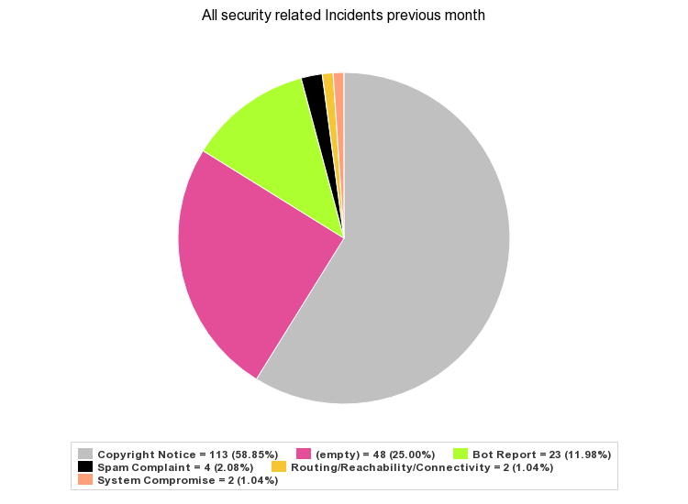
Security Operations and Response
OARnet Security Incidents by month
Month | Count
October 15 | 260
November 15 | 202
December 15 | 483
January 16 | 192
February 16 (partial) | 109
OARnet Member Confidential – do not distribute

Slide 7
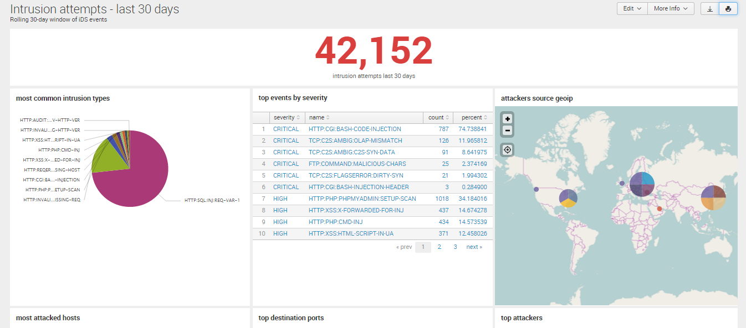
Security Operations and Response
OARnet Member Confidential – do not distribute

Slide 8
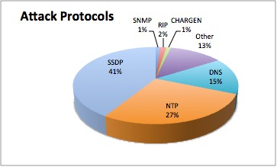
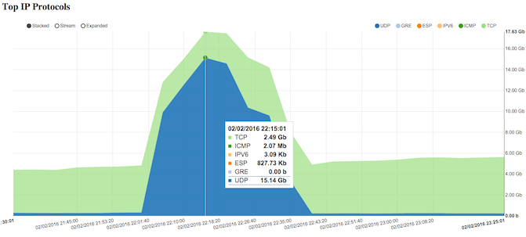
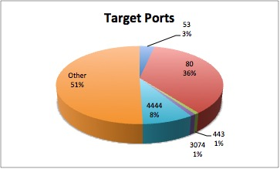
Security Operations and Response
Distributed Denial-of-Service (DDoS) Attack Stats
Largest attack: 18.9Gb/s (January, 2016) • Average attack: 1.8Gb/s
67 unique clients have been targets, including all K12
Sample Alert (Alpha Test!)
Suspected UDP (D)DoS Attack - Client: <redacted>
Service: INTERNET, Router: <redacted> - xe-1/0/0.395, ifIndex: 504
UDP: 16.15 Gbps, TCP: 424.44 Mbps, Total: 16.57 Gbps
UDP Src Port: 0 53, UDP Dest Port: 0 4444, Destination IP: 64.247.117.58
Also comes with pre-fetched netflow reports and interface statistics (packets, bps, drops, etc)
OARnet Member Confidential – do not distribute

Slide 9
Security Best Practices
DNS
RTBH
Vendor solutions being explored
On-premises vs. cloud “scrubbing” vs. hybrid
What can be achieved across consortium depends on funding level
Incident & Escalation
Make sure your security contact information for your institution is up to date

Slide 10
Security Operations and Response
OARnet DNS
8 servers, 2 different OS’s (secure64 + FreeBSD)
½ recursive, ½ authoritative
Blind-master setup
Contact: Nick Wolff nwolff@oar.net or Support Desk support@oar.net

Slide 11
RTBH (aka BGP Null Route)
Remotely triggered
black hole
Mechanism:
Client sends specific host /32 route to OARnet tagged with appropriate BGP community value
600:99 for Internet
3112:99 for Internet2
OARnet backbone router sets next hop to discard
Once BGP policy is configured, client can send prefixes without escalating to OARnet

Slide 12
RTBH (aka BGP Null Route)
Considerations:
Target IP will not be able to communicate with Internet. (Yes, this may have been the intent...)
However, this may allow the rest of your network to stay up during the attack!
Strongly encourage clients to set up RTBH for use when needed
Contact: Security@oar.net or Support@oar.net

Slide 13
Vendor Updates
Duo www.duosecurity.com
Multi-factor authentication
In use (in various phases) at OSU, CWRU, UC, and Kent
Available via Internet2 http://www.internet2.edu/products-services/cloud-services-applications/duo-security/
Palo Alto www.paloaltonetworks.com
Next-generation firewall
In use at a number of institutions
After some discussion of potential arrangements, vendor will not be offering a consortium-wide contract, so contact your preferred reseller if interested
Airwatch www.air-watch.com/
Mobile Device Management, Mobile Security Management
Available through OARnet’s VMWare reseller agreement
Contact your OARnet Client Services rep https://oar.net/services/member_schools_contact

Slide 14
Thank you
OARsec

