Slide 1

Development & Implementation of a Secure LAN Strategy
Scott McCollum
Director, ITS & Chief Technology Officer
Darnell Brown
Senior Infrastructure Engineer

Slide 2
Sinclair Community College
Founded in 1887 as a YMCA night school.
David A. Sinclair was the director of the Dayton YMCA.
One of 20 board members of the League for Innovation in the Community College.
Has received more NSF grant funds than any other US Community College.
Lowest cost tuition in the state of Ohio ($51.20/hr).
26,000 students and 2,000 employees.
55 acre, 20 building Dayton campus.
5 remote sites, multiple partner locations.
240 servers, 5,400 PCs, 80 TB storage.

Slide 3
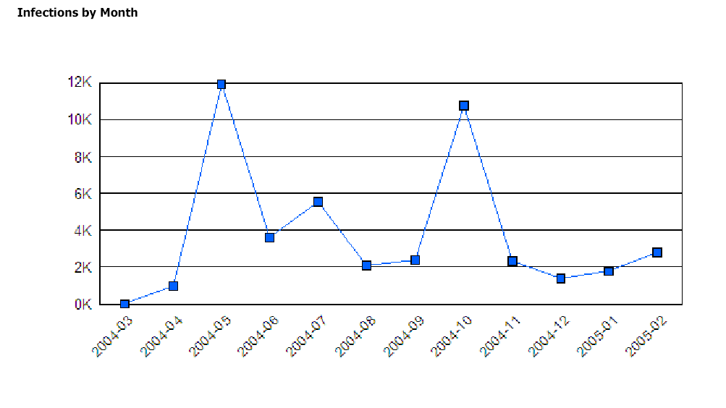
The problem…
Blaster/
Nachi
Sasser

Slide 4
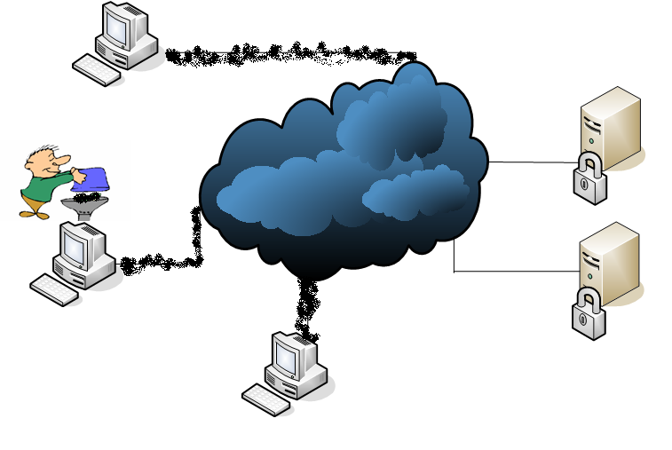
NAC:Protecting the entry point as well as the destination

Slide 5




NAC seems to be everywhere…

Slide 6
What is NAC
Typical NAC implementations include:
  Authentication of user and/or device
  Restriction of traffic types
  Compliance verification of computer with policy
  Quarantine of non-compliant systems
  Remediation of problems
Many proprietary implementations
Trusted Computing Group’s (TCG) TNC architecture
Formed to develop, define and promote open, vendor-neutral, industry standards for trusted computing building blocks and software interfaces across multiple platforms.

Slide 7
Sinclair’s approach
Identify the Secure LAN strategy that would address our needs
Evaluate the existing capabilities of the network to support the strategy
Identify changes that needed to be made to the network to fill the gaps

Slide 8
What does the strategy need to take into consideration
The Good
  Wide-spread use of standard image
  Images built and maintained centrally
  Lab computers “locked down”
  Image = Secure (relatively)
  Automated account management and processes for creating exceptions (Non-employees and generic)
  AD is the repository for all known-users and known-devices (at least Windows)
The Bad
  Employees are local administrators of PCs
  Inability to force the image, support for non-imaged PCs (and some weird things)
The Ugly
  Many “open” jacks in public and unsecured spaces
  Growing demand for wireless and concern over its security and support
  Rapidly expanding number and types of personal wireless devices

Slide 9
The Secure LAN Strategy
Sinclair Network Access Levels
Access Level | User | Device
Level One This is the highest level of access. The user must login with their Sinclair network username and password. | College Employees and Students This includes all faculty, staff, and student employees. It also includes student use of login IDs that are assigned to campus lab computers. | College-Owned Computers including Laptops and Tablet PCs with the Sinclair Windows Image
Level Two “Web Only” access similar to the type of access when connected to the Internet off-campus. The user must login with their Sinclair network username and password. | College Employees and Students This includes all faculty, staff, and student employees. It also includes student use of login IDs that are assigned to campus lab computers. | Devices without the Sinclair Windows Image or Not Owned by the College Examples would include PDAs, non-imaged laptops, personal laptops, smart phones, etc.
Level Three This is a “Guest” access granting “Web Only” access similar to when a user is connected to the Internet off-campus. A login is NOT required. | Anyone This includes all students and the public. | Any Type of Device

Slide 10
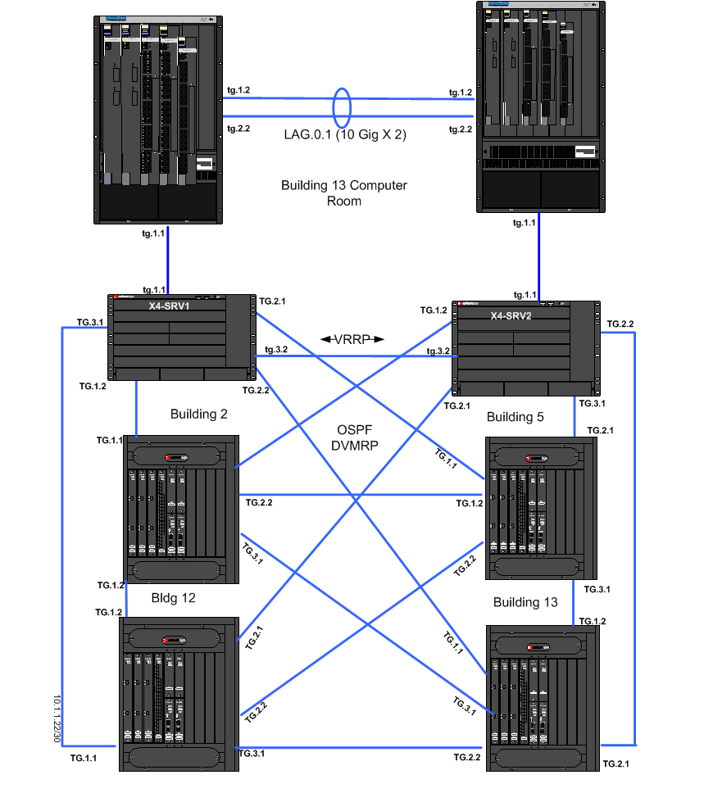
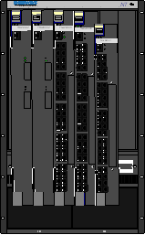
Servers
User Edge

Slide 11


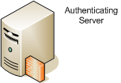
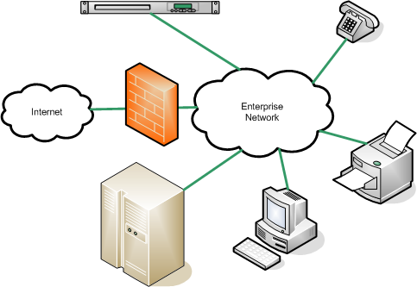

Network Authentication –
Standards-based 802.1x

Slide 12
Policies at a Glance
Each organizational role incorporates rules from our acceptable use policy.
USER Role
Deny source port 25,80,1434 and 67.
This prevents computers authenticated into the USER role from masquerading as unauthorized servers.
Contain all network traffic from ports assigned to the USER role to a specific VLAN.
This rule keeps the approved network traffic isolated from the unapproved broadcast traffic. Increased benefits when using multiple vlans.

Slide 13
Policies at a Glance
USER Role (continued)
Containment Rules - Prevent bilateral communication on tcp and udp ports 1023, 5554 and others to specific ip addresses and/or URL’s.
This type of rule is critical when a virus or Trojan is introduced to the network, i.e.. Nimda, Sasser, etc.

Slide 14
Policies at a Glance
Printers/MF-Printers Role
Default Action- Deny all traffic by default in the production vlan
Allow source port 161(SNMP). Allow bilateral ports 23, 9100 and other specific printer ports for communication
This rule is locked down to only allow specific traffic on the production vlan. If a mac address is spoofed, the end device/user will only have access to the network with the ports allowed in the role.

Slide 15
Policies at a Glance
Printers/MF-Printers Role (continued)
Non 802.1X-Mac Authentication
Default Action- Deny all traffic by default in the production vlan
Allow source port 161(SNMP). Allow bilateral ports 23, 9100 and other specific printer ports for communication
This rule is locked down to only allow specific traffic on the production vlan. If a mac address is spoofed, the end device/user will only have access to the network with the ports allowed in the role.

Slide 16
Policies at a Glance
VOIP Phone Role
The ShoreTel IP Phone role provides prioritized VoIP traffic on the network for ShoreTel phones that use the MGCP Protocol. The VoIP signaling and call control protocol are set to high priority while all other traffic is set to Class of Service Priority 3.
Default Action- Contain all VOIP traffic to the VOIP VLAN.
Prioritize MGCP,RTP, and FTP over non latency sensitive protocols.

Slide 17
Policies at a Glance
Other Roles
  Corporate User
  Guest Access
  Projector
  Tartan Card
  Unregistered
  Quarantine
  Mac Computer

Slide 18
Timeline
Define Strategy
(10/04)
System Installation (2/05)
Define AUP (12/04)
NAC roll-out (9/05 thru 2/07)

Slide 19

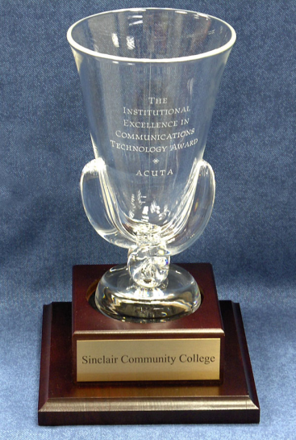

Awards and Recognition
“ACUTA, the Association for Communications Technology Professionals in Higher Education, has chosen Sinclair Community College as the recipient of the Institutional Excellence in Communications Technology Award for 2006.”
“Sinclair Community College selected as one of the winners in Network World's Enterprise All-Star Award program”
“Campus Technology Magazine Spotlights Sinclair's Secure LAN Project”

Slide 20
Issues
Each component acts on its own – DHCP, PC, Windows, switch, Radius
Timing and delays in Windows login
  PXE boot
  Auto-negotiation issues
  Transition time from purgatory
No central repository of status or actions taken
Staffing models to develop new skills in front-line support
Can’t afford to involve systems and network engineers in troubleshooting PCs
Dynamic egress – related to role-based dynamic VLAN assignment
Knowing what you have

Slide 21
Balancing Value Against Issues
Benefits
Costs
Improved security
Intermittent failures
Troubleshooting complexity
Continual learning
Additional procedures

Slide 22
Network Authentication - with NAC Appliance
NAC Appliance

Slide 23
Enterasys NAC Solution
What are the benefits from the implementation of the NAC solution?
How can we improve response time to network access failures?
What are other ways we can provide greater access to network resources while keeping a high level of security?

Slide 24
Leverage Existing
Policy-Enabled Architecture
Security and compliance mandates require “Least Privilege”
  Limit users access to only those resources they need to do their job
  What a user Needs and want they want are often different
  Should control which resources a user is authorized to access
  Should control which application can be used for each resource
  Based on role in organization
NAC provides extended control
  Authenticated role
  Type of authentication
  Type of device
  Location Port, Switch, SSID
  Time of day
  Security state of device

Slide 25
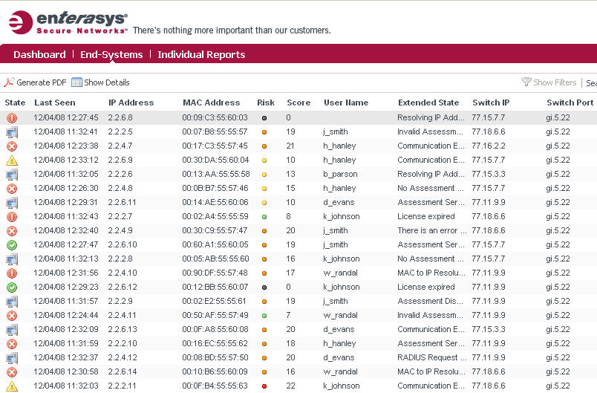
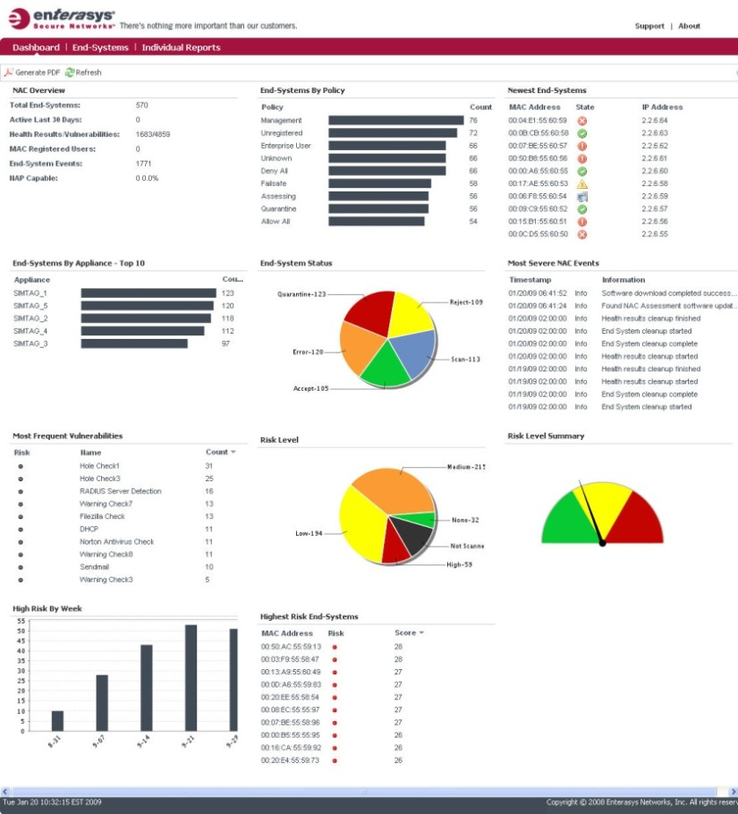
End System Monitoring
Automatic end system inventory and control
  Connected port
  Assigned role
  User identity
  Last assessment
  Security status
  Overall 45 attributes per end system
NAC Reporting
  Risk Level
  Highest Risk End Systems
  Newest End Systems
  Most Frequent Vulnerabilities
  End Systems by Vulnerability

Slide 26
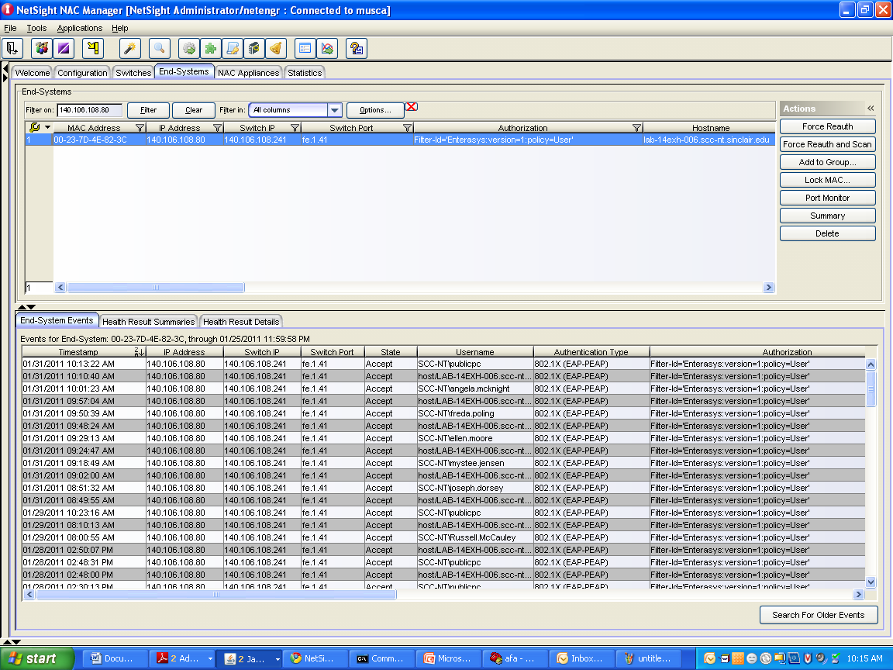
Increased visibility and granularity

Slide 27
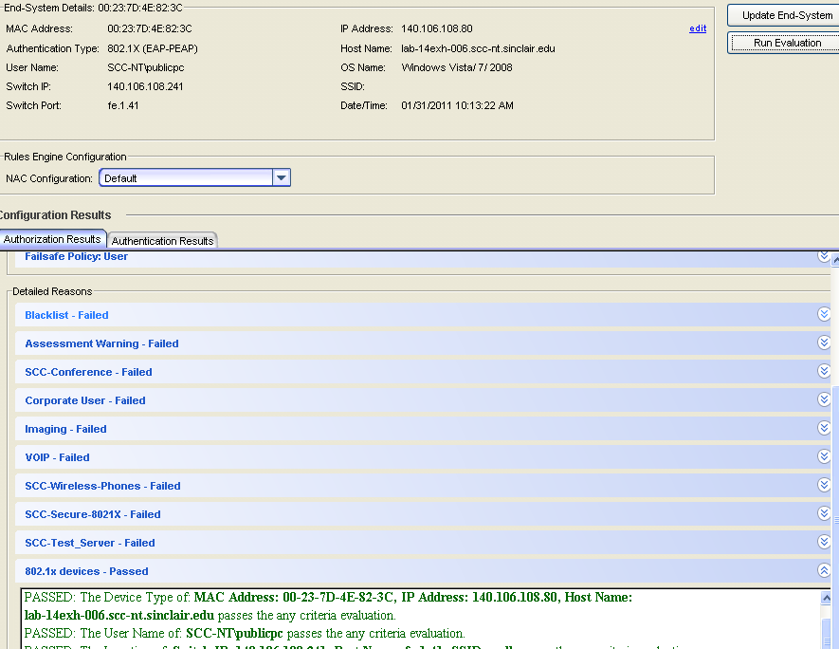
End System Evaluation

Slide 28
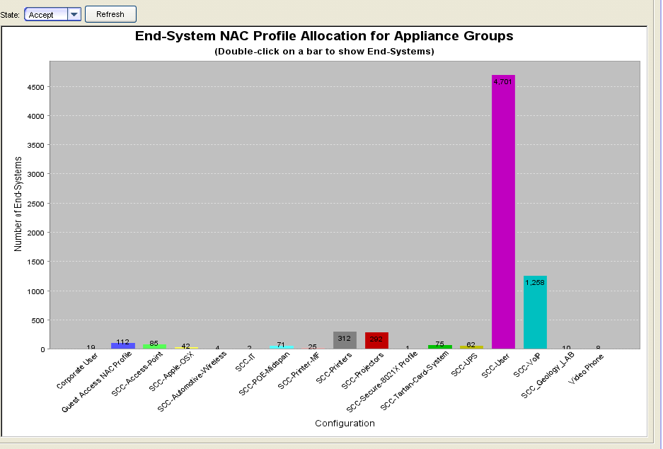
Notification and Reporting

Slide 29
Enterasys NAC Demonstration
Visibility into the authentication process.
Identification of an unknown device and user.
Walk through the guest registration process and subsequent approval of network access.

